Slide 1
SHOOTING STAR
THREE PERSON BUZZER

Slide 2
http://www.netshop168.com/goods-4364.html
http://www.netshop168.com/goods-4363.html
http://www.netshop168.com/goods-4362.html
http://www.netshop168.com/goods-4361.html
http://www.netshop168.com/goods-4360.html
http://www.netshop168.com/goods-4359.html
http://www.netshop168.com/goods-4358.html
http://www.netshop168.com/goods-4357.html
http://www.netshop168.com/goods-4356.html
http://www.netshop168.com/goods-4355.html
http://www.netshop168.com/goods-4354.html
http://www.netshop168.com/goods-4353.html
http://www.netshop168.com/goods-4352.html
http://www.netshop168.com/goods-4351.html
http://www.netshop168.com/goods-4350.html
http://www.netshop168.com/goods-4349.html
http://www.netshop168.com/goods-4348.html
http://www.netshop168.com/goods-4347.html
START
http://www.netshop168.com/goods-4346.html
http://www.netshop168.com/goods-4345.html
http://www.netshop168.com/goods-4344.html
http://www.netshop168.com/goods-4343.html
http://www.netshop168.com/goods-4342.html
http://www.netshop168.com/goods-4341.html
http://www.netshop168.com/goods-4340.html
http://www.netshop168.com/goods-4339.html
http://www.netshop168.com/goods-4338.html
http://www.netshop168.com/goods-4337.html
http://www.netshop168.com/goods-4336.html
http://www.netshop168.com/goods-4335.html
http://www.netshop168.com/goods-4334.html
http://www.netshop168.com/goods-4333.html
http://www.netshop168.com/goods-4332.html
http://www.netshop168.com/goods-4331.html
The host motioned for an
answer
FLOWCHART
Someone pressed button
Who is the first
http://www.netshop168.com/goods-4330.html
http://www.netshop168.com/goods-4329.html
http://www.netshop168.com/goods-4328.html
http://www.netshop168.com/goods-4327.html
http://www.netshop168.com/goods-4326.html
http://www.netshop168.com/goods-4325.html
http://www.netshop168.com/goods-4324.html
http://www.netshop168.com/goods-4323.html
http://www.netshop168.com/goods-4322.html
http://www.netshop168.com/goods-4321.html
http://www.netshop168.com/goods-4320.html
http://www.netshop168.com/goods-4319.html
http://www.netshop168.com/goods-4318.html
http://www.netshop168.com/goods-4317.html
The group name is displayed on the LCD and the Led flashes

Slide 3
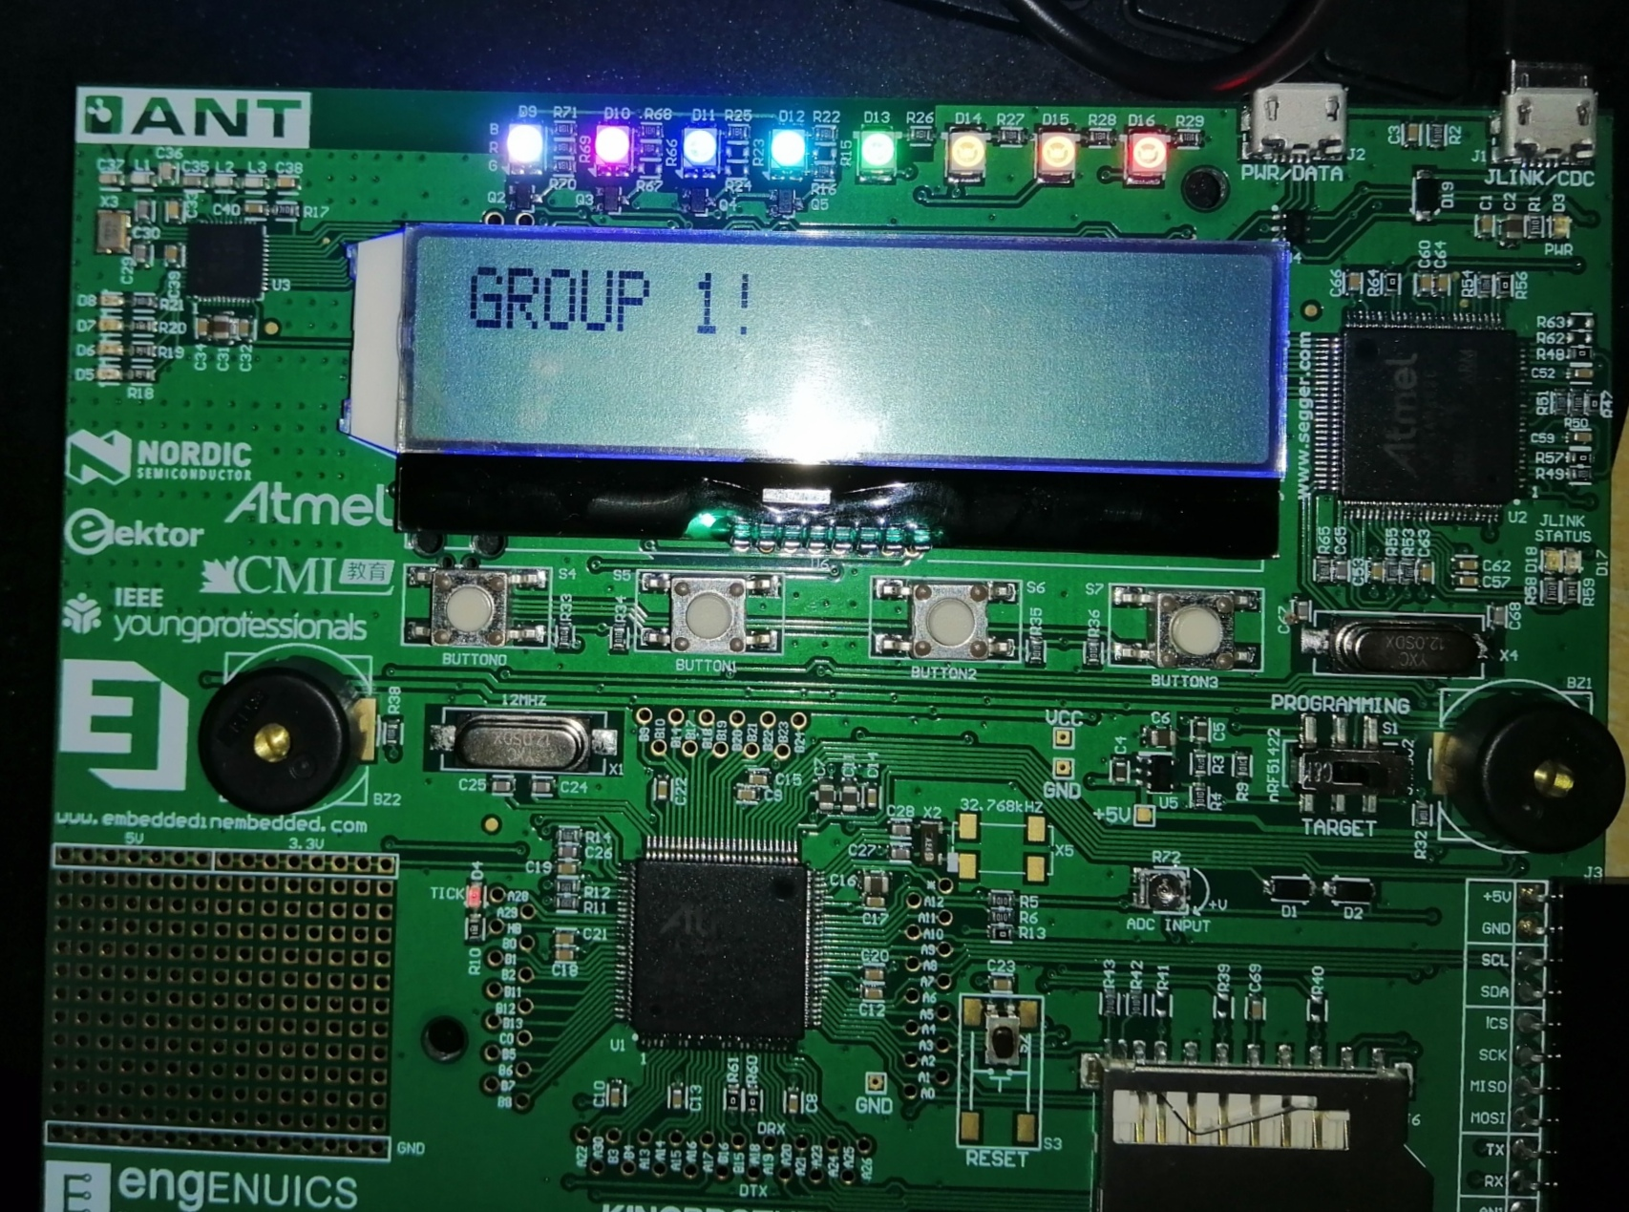
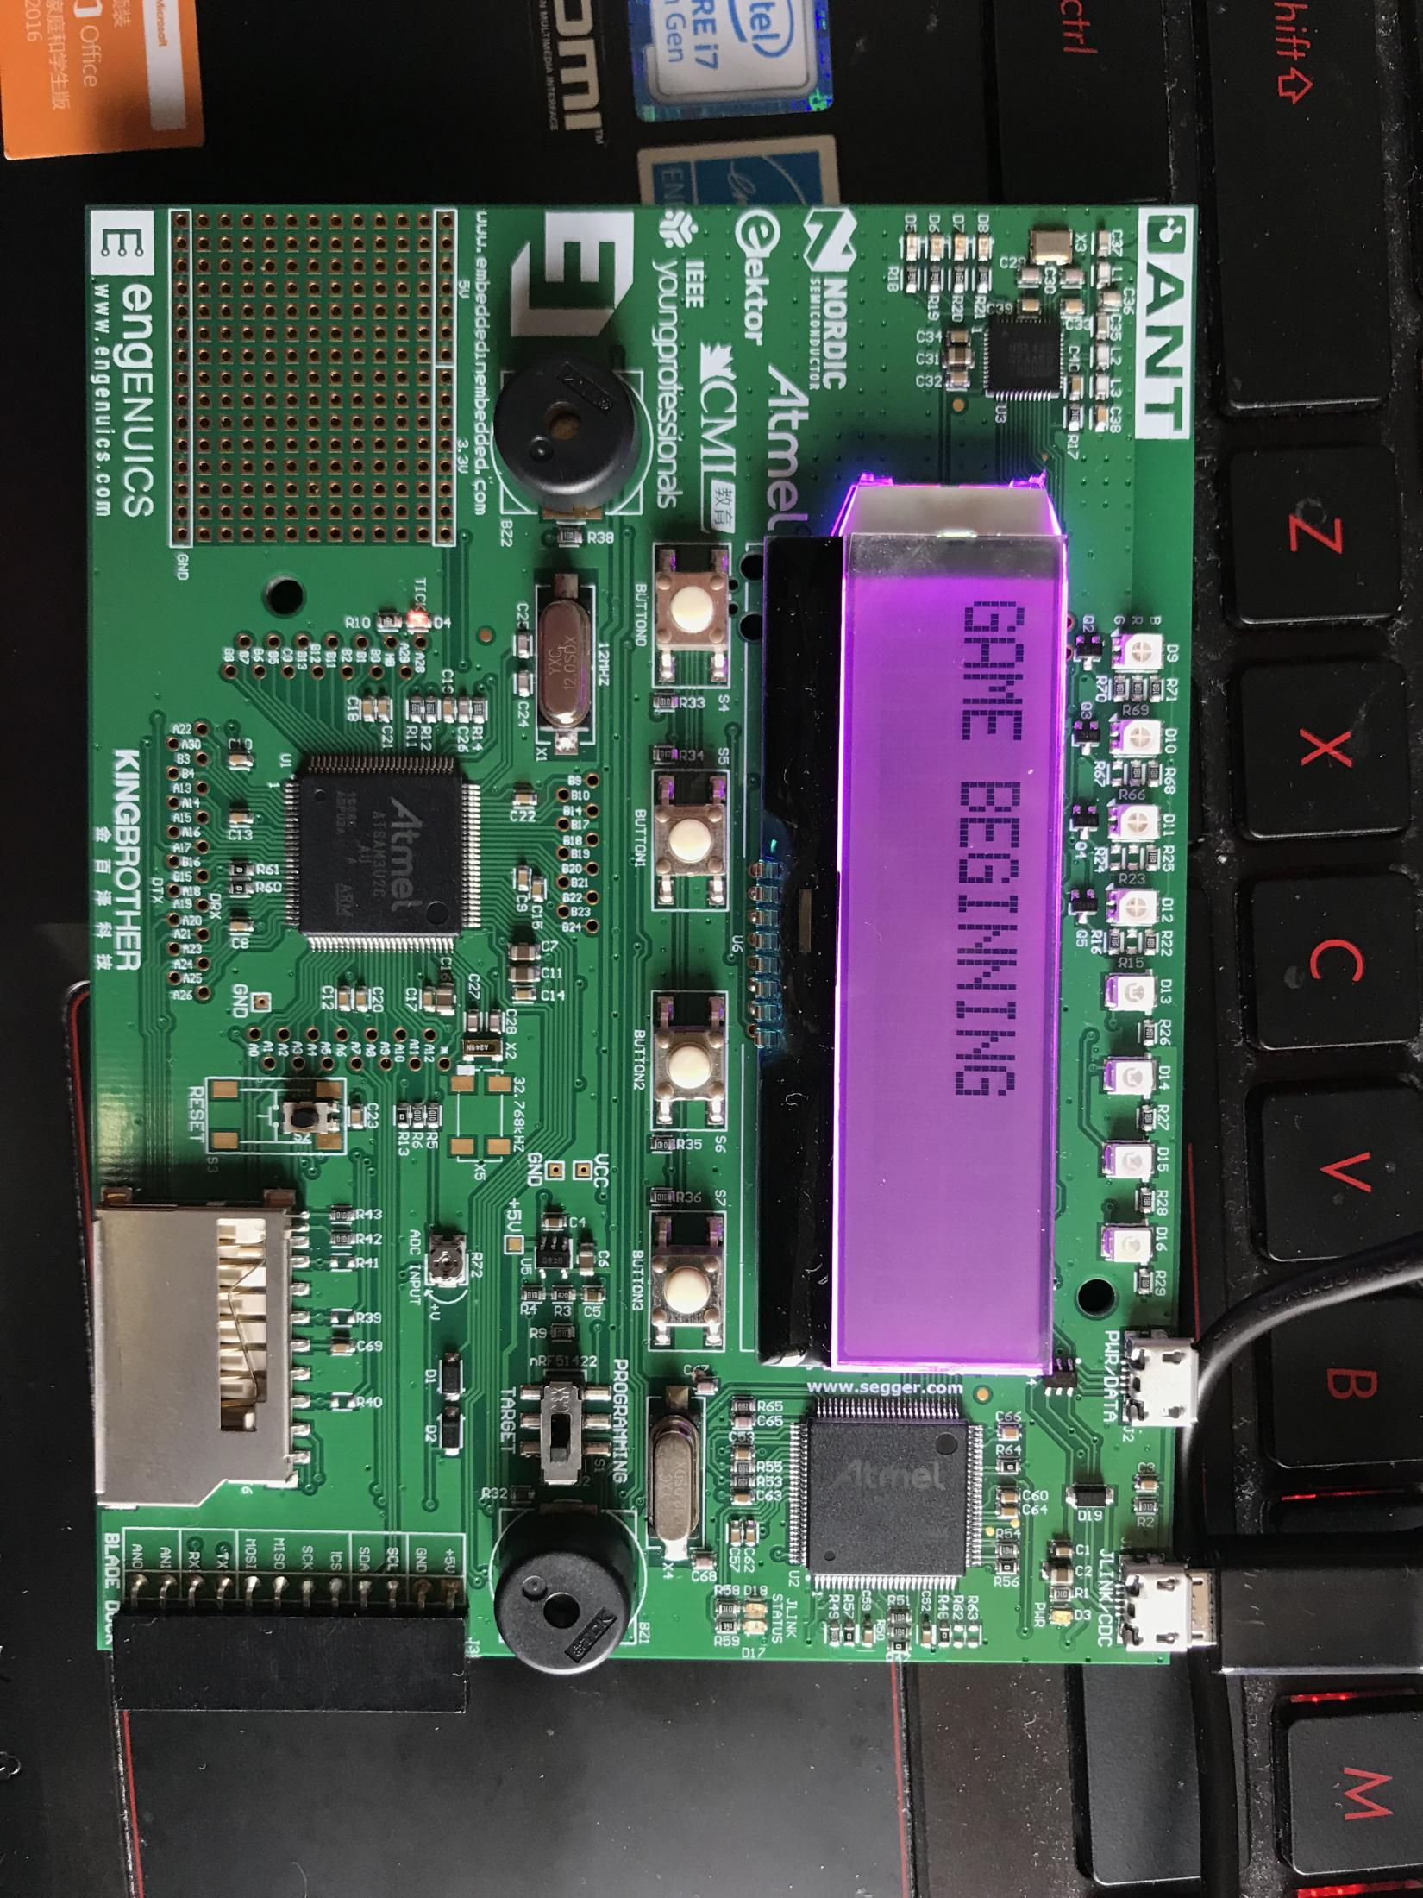
EXHIBITION

Slide 4
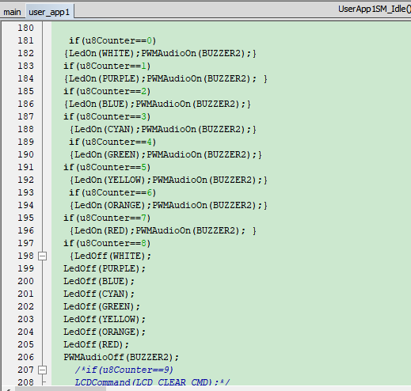
SOLVED
The buzzer continues to ring after the answer is over.
抢答结束后，蜂鸣器持续响

Slide 5

SOLVED
If you do not press the start button first, and then press the buzzer button, the group number of pressing the button by mistake will appear on the screen.
如果不是先按开始按钮，后按抢答按钮，屏幕上会出现误按按钮的组号
If one person successfully answers the question but answers the question incorrectly, the other two people cannot answer the question again and need to
reset.
如果一个人抢答成功，但回答问题错误，另外两个人无法再次抢答，需要按复位键。
PROBLEM

Slide 6
http://www.netshop168.com/goods-4113.html
http://www.netshop168.com/goods-4112.html
http://www.netshop168.com/goods-4111.html
http://www.netshop168.com/goods-4110.html
http://www.netshop168.com/goods-4109.html
http://www.netshop168.com/goods-4108.html
http://www.netshop168.com/goods-4107.html
http://www.netshop168.com/goods-4106.html
http://www.netshop168.com/goods-4105.html
http://www.netshop168.com/goods-4104.html
http://www.netshop168.com/goods-4103.html
http://www.netshop168.com/goods-4102.html
http://www.netshop168.com/goods-4101.html
http://www.netshop168.com/goods-4100.html
http://www.netshop168.com/goods-4099.html
http://www.netshop168.com/goods-4098.html
http://www.netshop168.com/goods-4097.html
http://www.netshop168.com/goods-4096.html
http://www.netshop168.com/goods-4095.html
http://www.netshop168.com/goods-4094.html
http://www.netshop168.com/goods-4093.html
http://www.netshop168.com/goods-4092.html
http://www.netshop168.com/goods-4091.html
http://www.netshop168.com/goods-4090.html
http://www.netshop168.com/goods-4089.html
http://www.netshop168.com/goods-4088.html
http://www.netshop168.com/goods-4087.html
http://www.netshop168.com/goods-4086.html
http://www.netshop168.com/goods-4085.html
http://www.netshop168.com/goods-4084.html
http://www.netshop168.com/goods-4083.html
http://www.netshop168.com/goods-4082.html
http://www.netshop168.com/goods-4081.html
http://www.netshop168.com/goods-4080.html
http://www.netshop168.com/goods-4079.html
http://www.netshop168.com/goods-4078.html
http://www.netshop168.com/goods-4077.html
http://www.netshop168.com/goods-4076.html
http://www.netshop168.com/goods-4075.html
http://www.netshop168.com/goods-4074.html
http://www.netshop168.com/goods-4073.html
http://www.netshop168.com/goods-4072.html
http://www.netshop168.com/goods-4071.html
http://www.netshop168.com/goods-4070.html
http://www.netshop168.com/goods-4069.html
http://www.netshop168.com/goods-4068.html
http://www.netshop168.com/goods-4067.html
http://www.netshop168.com/goods-4066.html
http://www.netshop168.com/goods-4065.html
http://www.netshop168.com/goods-4064.html
http://www.netshop168.com/goods-4063.html
http://www.netshop168.com/goods-4062.html
http://www.netshop168.com/goods-4061.html
http://www.netshop168.com/goods-4060.html
http://www.netshop168.com/goods-4059.html
l
http://www.netshop168.com/goods-4055.html
http://www.netshop168.com/goods-4054.html
http://www.netshop168.com/goods-4053.html
http://www.netshop168.com/goods-4052.html
http://www.netshop168.com/goods-4051.html
http://www.netshop168.com/goods-4050.html
http://www.netshop168.com/goods-4049.html
http://www.netshop168.com/goods-4048.html
http://www.netshop168.com/goods-4047.html
http://www.netshop168.com/goods-4046.html
http://www.netshop168.com/goods-4045.html
http://www.netshop168.com/goods-4044.html
http://www.netshop168.com/goods-4043.html
http://www.netshop168.com/goods-4042.html
http://www.netshop168.com/goods-4041.html
http://www.netshop168.com/goods-4040.html
http://www.netshop168.com/goods-4039.html
http://www.netshop168.com/goods-4038.html
http://www.netshop168.com/goods-4037.html
http://www.netshop168.com/goods-4036.html
http://www.netshop168.com/goods-4035.html
http://www.netshop168.com/goods-4034.html
http://www.netshop168.com/goods-4033.html
http://www.netshop168.com/goods-4032.html
http://www.netshop168.com/goods-4031.html
http://www.netshop168.com/goods-4030.html
http://www.netshop168.com/goods-4029.html
http://www.netshop168.com/goods-4028.html
http://www.netshop168.com/goods-4027.html
http://www.netshop168.com/goods-4026.html
http://www.netshop168.com/goods-4025.html
http://www.netshop168.com/goods-4024.html
http://www.netshop168.com/goods-4023.html
THANK YOU

